Slide 1
BCT 2305 Network Cabling
Making connections with Cat5

Slide 2
Overview
What cable types are available?
How do cables work?
How are cables used in networking?
How are connections made?

Slide 3
Learning Objectives
List common cable types used in networking
Describe how UTP cables are made
Explain how UTP cables are used in Ethernet networks
Demonstrate the ability to make a working patch cable
Name the two wiring standards used for wired Ethernet networks and their uses

Slide 4
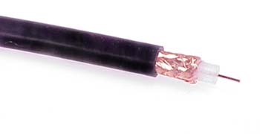
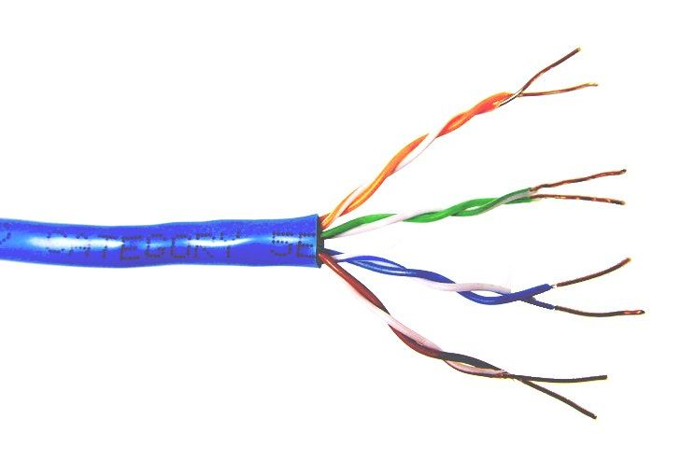
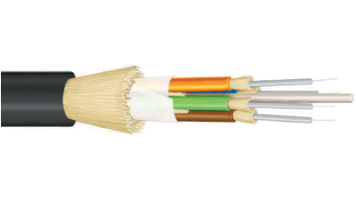
Common network cable types
Coaxial cable
Unshielded
twisted pair
Fiber optic

Slide 5
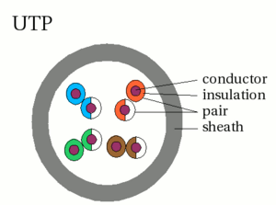
UTP characteristics
Unshielded
Twisted (why?) pairs of insulated conductors
Covered by
insulating sheath

Slide 6
UTP categories
Category 1 | Voice only (Telephone)
Category 2 | Data to 4 Mbps (Localtalk)
Category 3 | Data to 10Mbps (Ethernet)
Category 4 | Data to 20Mbps (Token ring)
Category 5 Category 5e | Data to 100Mbps (Fast Ethernet) Data to 1000Mbps (Gigabit Ethernet)
Category 6 | Data to 2500Mbps (Gigabit Ethernet)

Slide 7
Cat5e cable
1000Mbps data capacity
For runs of up to 90 meters
Solid core cable ideal for structural installations (PVC or Plenum)
Stranded cable ideal for patch cables
Terminated with RJ-45 connectors

Slide 8
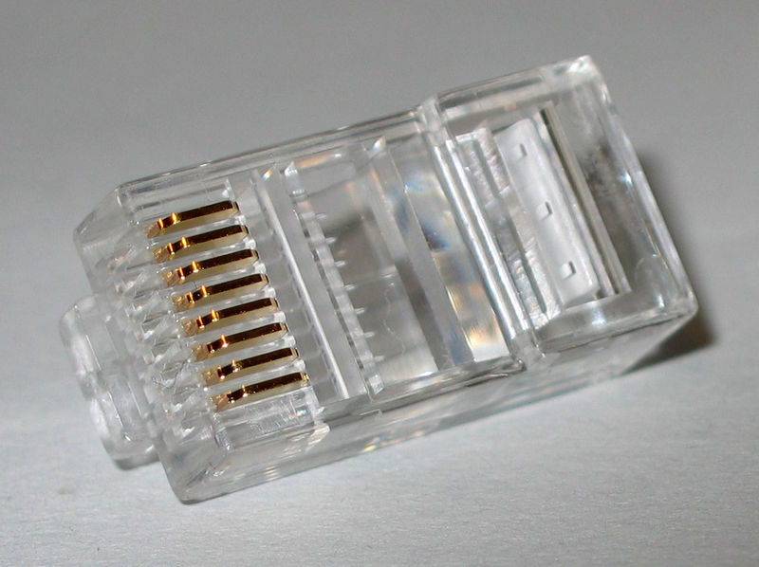
RJ45 connector

Slide 9

Making connections - Tools
Cat5e cable
RJ45 connectors
Cable stripper
Scissors
Crimping tool

Slide 10
Making connections - Steps
Strip cable end
Untwist wire ends
Arrange wires
Trim wires to size
Attach connector
Check
Crimp
Test

Slide 11
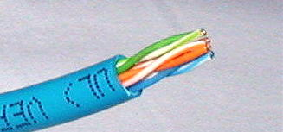
Step 1 – Strip cable end
Strip 1 – 1½” of insulating sheath
Avoid cutting into conductor insulation

Slide 12
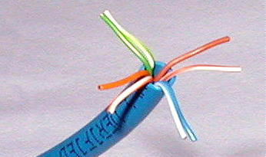
Step 2 – Untwist wire ends
Sort wires by insulation colors

Slide 13
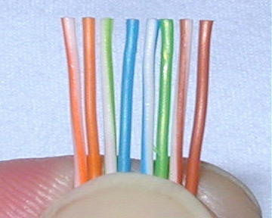
Step 3 – Arrange wires
TIA/EIA 568A: GW-G OW-Bl BlW-O BrW-Br
TIA/EIA 568B: OW-O GW-Bl BlW-G BrW-Br

Slide 14
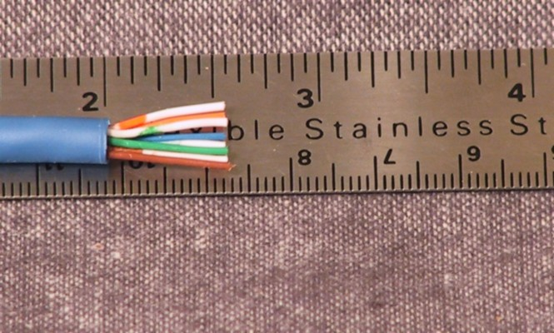
Step 4 – Trim wires to size
Trim all wires evenly
Leave about ½” of wires exposed

Slide 15
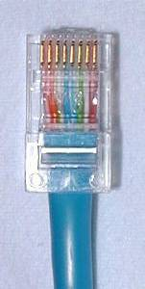
Step 5 – Attach connector
Maintain wire order, left-to-right, with RJ45 tab facing downward

Slide 16
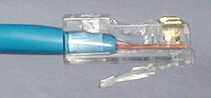
Step 6 - Check
Do all wires extend to end?
Is sheath well inside connector?

Slide 17
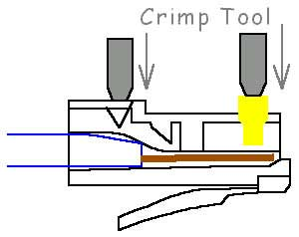
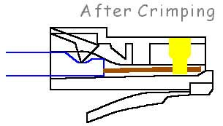
Step 7 - Crimp
Squeeze firmly to crimp connecter
onto cable end (8P)

Slide 18
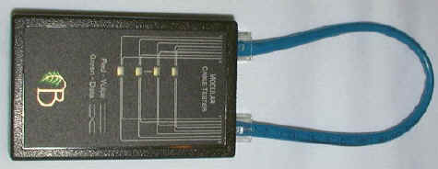
Step 8 – Test
Does the cable work?

Slide 19

Let’s go to work!

